Slide 1
Legal and Business Developments Regarding Ambulatory Surgery Centers
March 14, 2024
Mark R. Adams, Esq. Scott Trujillo, CPA

Slide 2
Index
Ambulatory Surgery Center (ASC) Basics
The Rapid Growth in ASCs
Choice of Entity for ASCs in Michigan
Legal Compliance Issues
Practical Tips for Representing an ASC
Practical Tips for Negotiating the Sale of an ASC
Development, Management and Operating an ASC

Slide 3
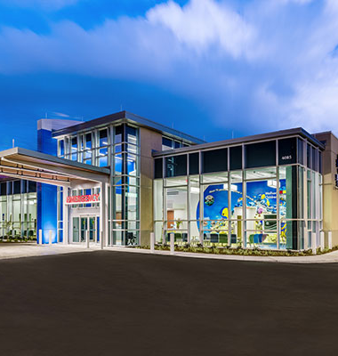
I. ASC Basics
What is an ASC?
Ambulatory surgery centers (“ASCs”) are modern healthcare facilities focused on providing same-day surgical care, including diagnostic and preventive procedures. Medicare first approved payments to ASCs in 1982.

Slide 4
I. ASC Basics (cont’d)
ASCs are medical entities that provide outpatient surgical care on a diagnostic and preventive procedures level without the headaches that often accompany receiving such procedures at an inpatient hospital. They can offer patients several advantages over traditional hospital-based surgical procedures, including shorter wait times, lower costs, and smaller chances of infectious disease exposure.

Slide 5
I. ASC Basics (cont’d)
An ASC must be certified and approved to enter into a written agreement with CMS. Participation as an ASC is limited to any distinct entity that operates exclusively for the purpose of providing surgical services to patients not requiring hospitalization and in which the expected duration of services would not exceed 24 hours following an admission. An unanticipated medical circumstance may arise that would require an ASC patient to stay in the ASC longer than 24 hours, but such situations should be rare.

Slide 6

I. ASC Basics (cont’d)
4. Michigan Freestanding Surgical Outpatient Facility (FSOF) Statute
Michigan statutes and other legal authority refer to ASCs as both ambulatory surgery centers and freestanding surgical outpatient facilities (“FSOFs”). FSOFs shall: (a) Be organized, administered, staffed, and equipped to provide on a regular and scheduled basis major and minor surgical procedures outside a hospital which in a physician's judgment may be safely performed on a basis other than on an inpatient basis. (b) Have the physician, professional nursing, technical, and supportive personnel; the technical, diagnostic, and treatment services; and the equipment necessary to assure the safe performance of surgery and related care undertaken in the facility. (c) Have a written agreement with a nearby licensed hospital to provide for the emergency admission of postsurgical patients who for unpredictable reasons may require hospital admission and care. (d) Assure that a clinical record is established for each patient including a history, physical examination, justification for treatment planned and rendered, tests and examinations performed, observations made, and treatment provided. MCL 333.20821

Slide 7

I. ASC Basics (cont’d)
Special Michigan ASC Requirements
A qualified anesthesiologist or anesthetist shall be present where medically necessary to evaluate and select the most appropriate anesthetic agent to be used and to supervise or administer the anesthetic.
Surgical procedures must be performed by licensed and credentialed health professionals. A physician or registered professional nurse shall be onsite until all surgical patients have been discharged and leave the health facility.
A facility shall have a written policy and procedure, adopted by the medical staff, to provide for adequate surgical hand-scrub throughout the surgical operative and postoperative procedure.
Surgical equipment, instruments, and supplies must be maintained in sufficient quantities, stored in a sanitary environment, and maintained in accordance with the applicable manufacturer guidelines and nationally recognized infection prevention and control guidelines published by certain designated organizations (e.g., Centers for Disease Control and Prevention). Mich. Admin. Rule 325.45337

Slide 8
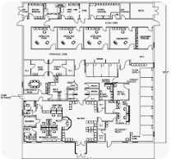
I. ASC Basics (cont’d)
6. ASC Site Layout
Waiting room and reception area.
Pre-op room.
Procedure or operating room (OR).
Patient discharge/pick-up area.
A main entrance that is separate from the patient post-procedure exit door.

Slide 9

I. ASC Basics (cont’d)
ASC Procedures
Eye surgery.
Knee, hip, and other joint surgeries, including joint replacement surgeries.
Spine surgeries.
Ear/nose/throat surgery, including removal of tonsils and adenoids.
Cosmetic surgeries, including breast reconstruction and skin grafts.
Urologic procedures, including vasectomy.
Other surgical procedures.

Slide 10
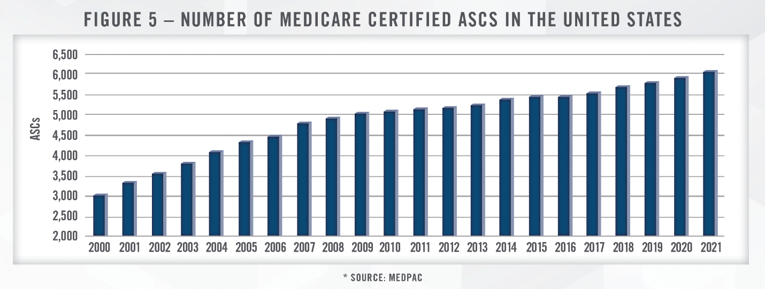
II. The Rapid Growth in ASCs

Slide 11
A. Recent news reports on ASC growth
60% of U.S. health systems are considering ASC joint ventures.
60% of health care providers indicate they would consider a joint venture partnership in the ASC service line area.
Number of Medicare Certified ASCs in the U.S.
Overall, the ASC market is projected to continue to grow, and alternative business models will be developed as the key players look to maximize efficiency and clinical success.
Google search on “ASC growth.”

Slide 12

B. Reasons for the explosive growth in ASCs

Slide 13
B. Reasons for the explosive growth in ASCs (cont’d)
Significant economic advantages to patients and payers. An increasing portion of healthcare providers' revenue is now coming directly from patients. More than 75 percent of patients with employer-sponsored coverage are enrolled in a health plan with an annual deductible and more than 50 percent of covered patients are enrolled in a high-deductible plan. The average family plan has an annual average deductible of at least $8,000.
CMS and commercial insurance payers are updating their policies, which updates are anticipated to accelerate the transition of more complex surgical procedures to ASCs that have been proven to be safely performed with high quality and less cost. ASC reimbursement rates are currently approximately 50% of hospital-based billing rates.
Comfortable, efficient, and effective surgical facility.
In recent years, several higher-acuity and higher-reimbursed procedures have been added to the ASC-payable list, and this trend is expected to continue.
ASCs can be much more profitable than inpatient surgical facilities. For example, a recent survey indicates the nations top (90th percentile) ASCs generate a 40% profit margin.

Slide 14
III. Choice of Entity for ASCs in Michigan
Under Michigan’s Corporate Practice of Medicine (“CPOM”) Rules, providers of professional health services must generally organize as one of the following entities owned by licensed physicians: sole proprietorships, professional service corporations (PCs), professional limited liability companies (PLCs or PLLCs); or ii) nonprofit corporations.

Slide 15
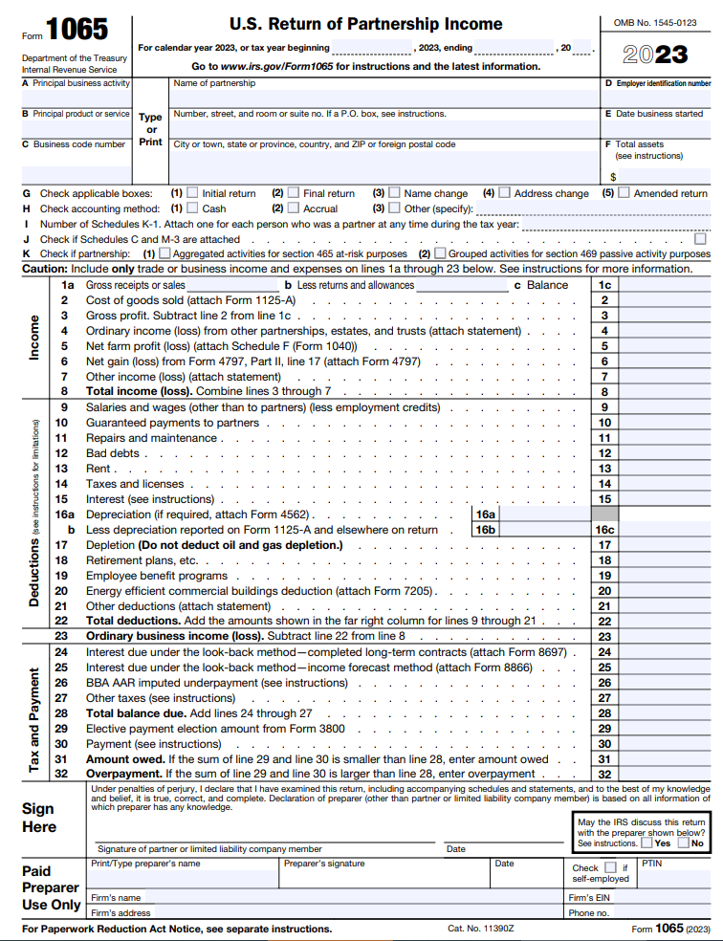
III. Choice of Entity for ASCs in Michigan (cont’d)
B. Why are most Michigan ASCs organized as Michigan limited liability companies (LLCs)?

Slide 16

IV. Legal Compliance Issues
A. ASC Billing Basics
Facility Fee
Surgical Fee
Anesthesia Fee
Federal Stark Issues
Federal Anti-Kickback Issues
False Claims Act and Other Federal Authority
State of Michigan Laws
1. Michigan Health Care False Claims Act. MCL 752.1004

Slide 17

V. Practical Tips for Representing an ASC
Remember, the entity, and not the Members or Managers are your client.
“A lawyer employed or retained by an organization represents the organization acting through its duly authorized constituents.” MRPC 1.13
Prepare for competing and conflicting opinions, positions, and egos, and maintain your objectivity.
Noncompete covenants.

Slide 18

VI. Practical Tips for Negotiating the Sale of an ASC
The market for purchasing ASCs is very active.
Selling the enterprise versus holding it and generating cash flow.
Prepare for competing and conflicting opinions.
Administer the negotiations via a unified method and message.
Have only one designated person be the negotiator with the Buyer.
Make it clear that if members engage their own attorneys, they are responsible for the fees.
If selling a portion (typically at least 51%) of the equity interests to a third party, be prepared for lengthy, complicated and buyer-oriented transaction documents, including a new Amended and Restated Operating Agreement.
At the beginning of the transaction document the ground rules for administering the transaction via Consent Resolutions of the members and Managers.

Slide 19
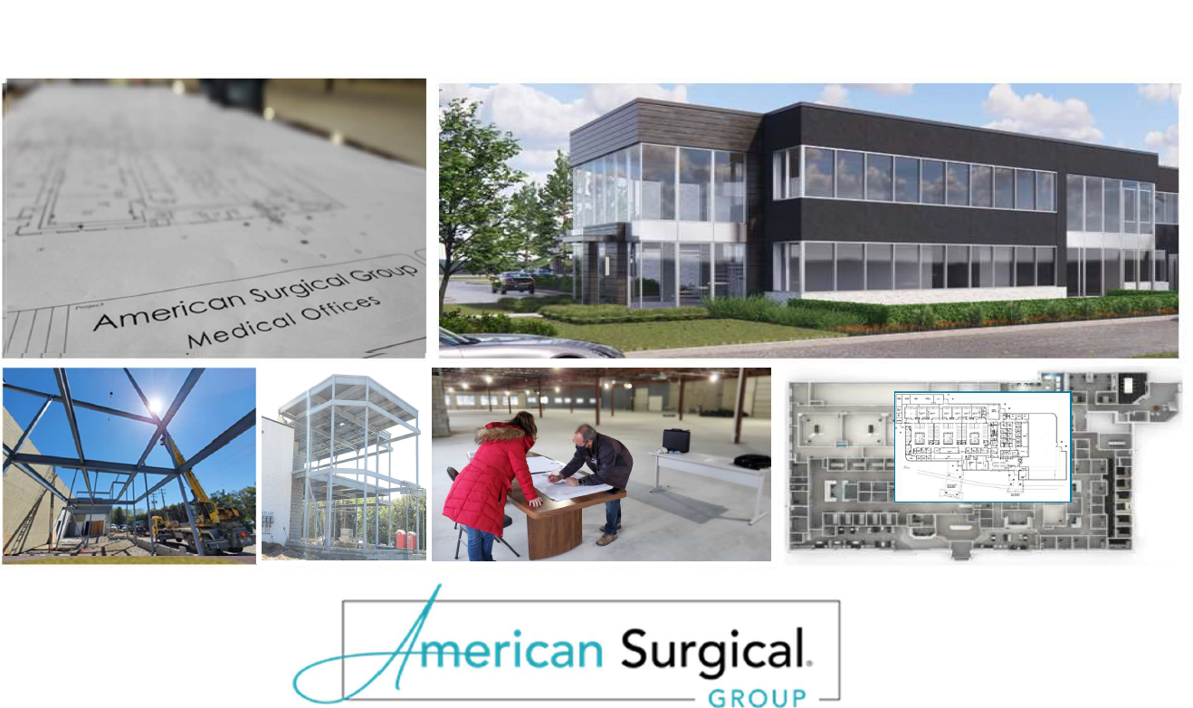

Slide 20
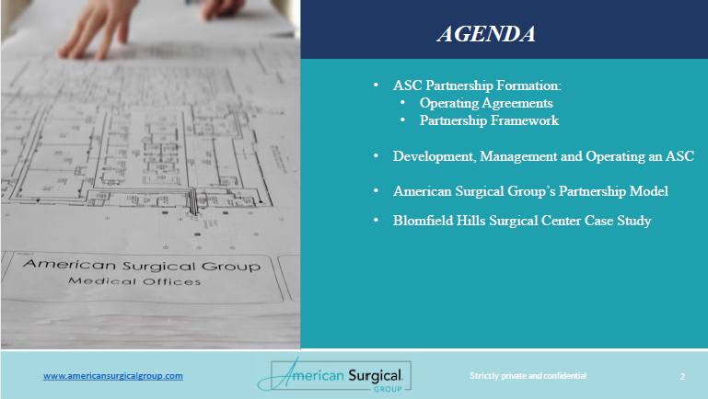

Slide 21
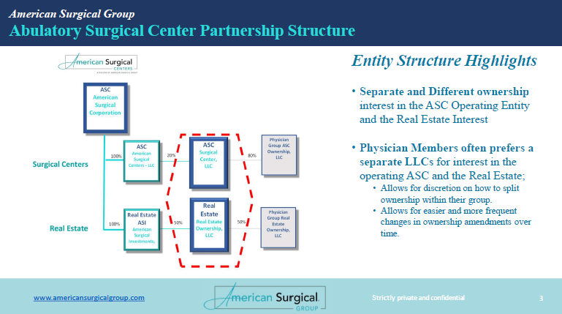

Slide 22
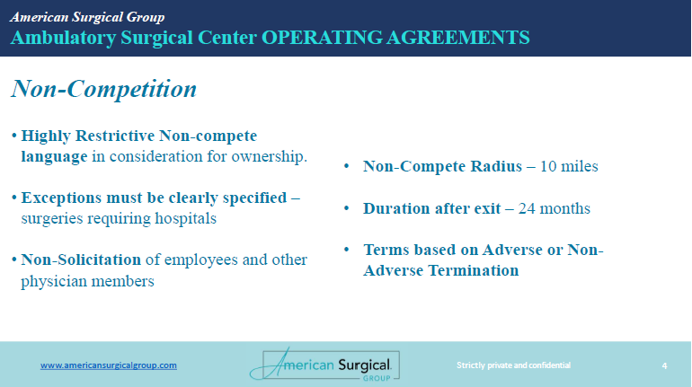

Slide 23
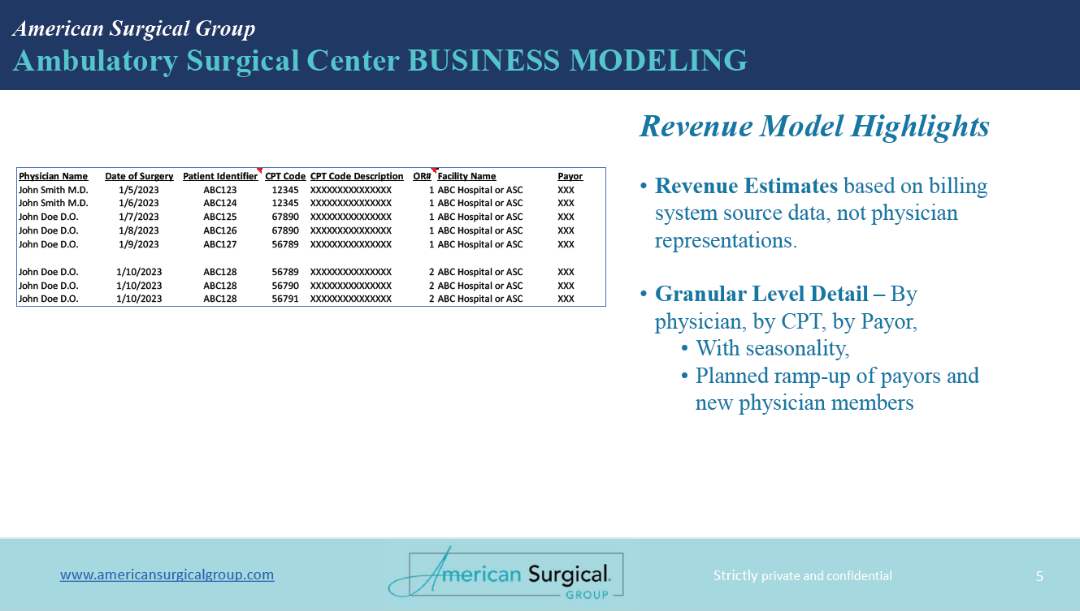

Slide 24
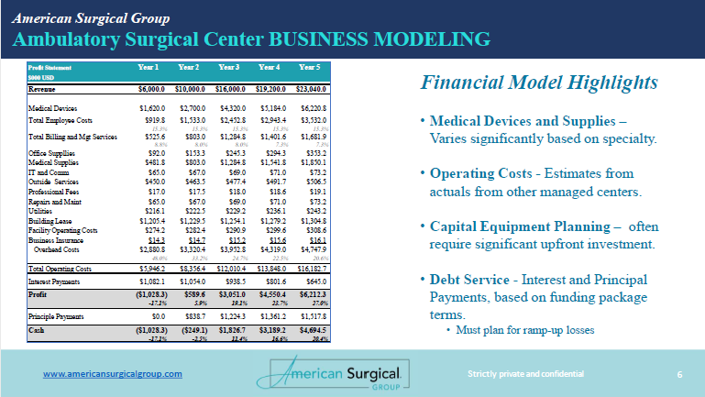

Slide 25
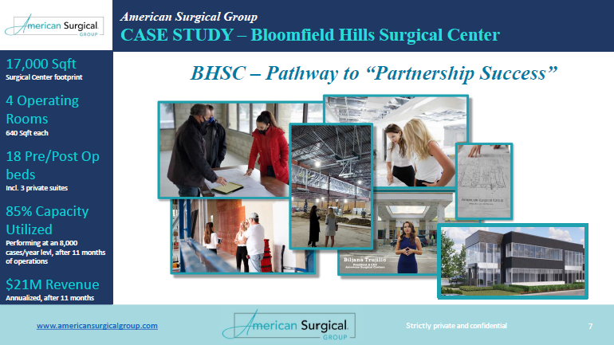

Slide 26
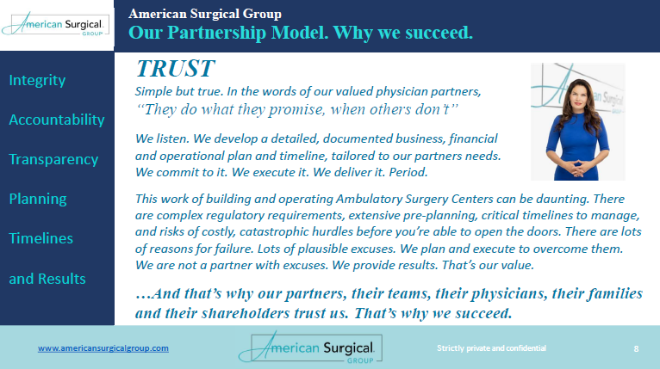

Slide 27
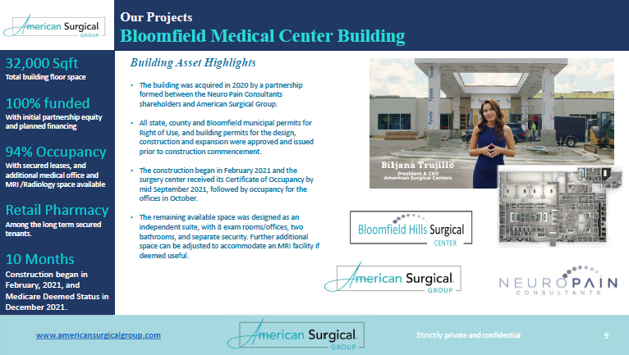

Slide 28
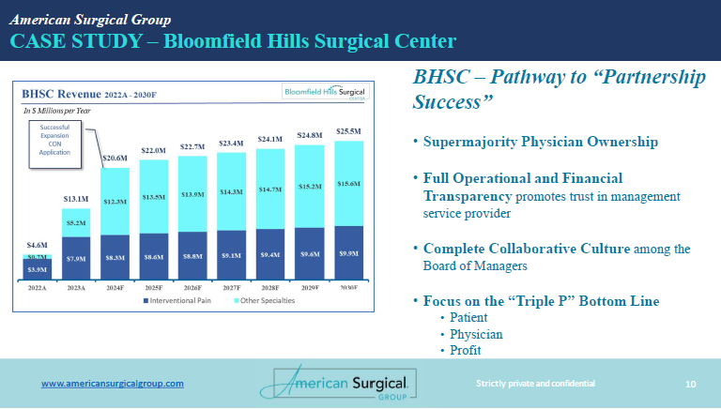

Slide 29
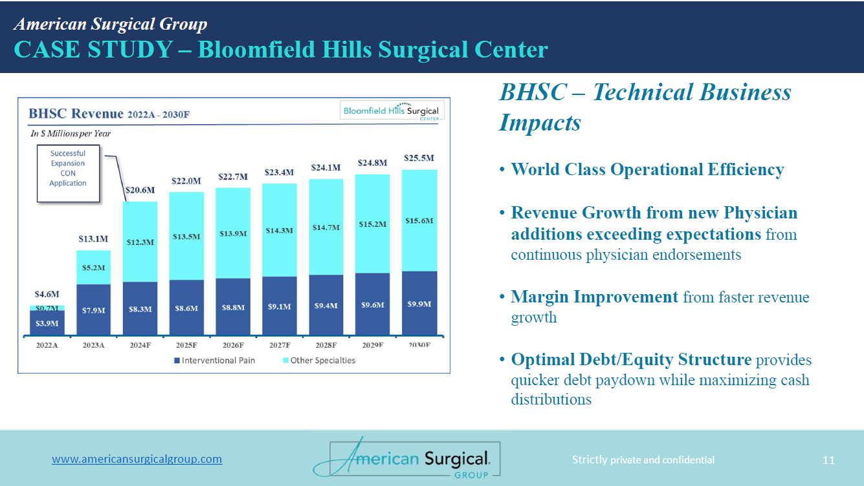

Slide 30
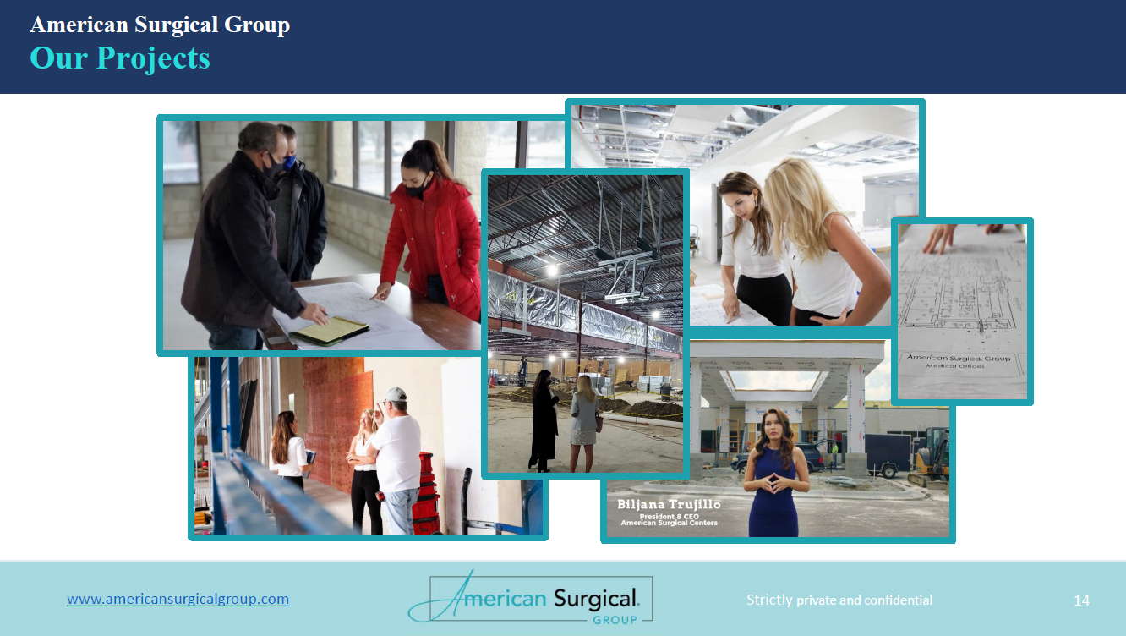

Slide 31
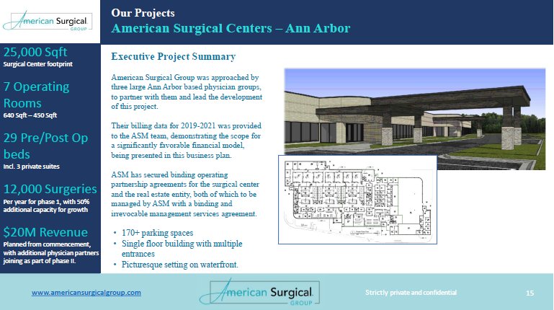

Slide 32
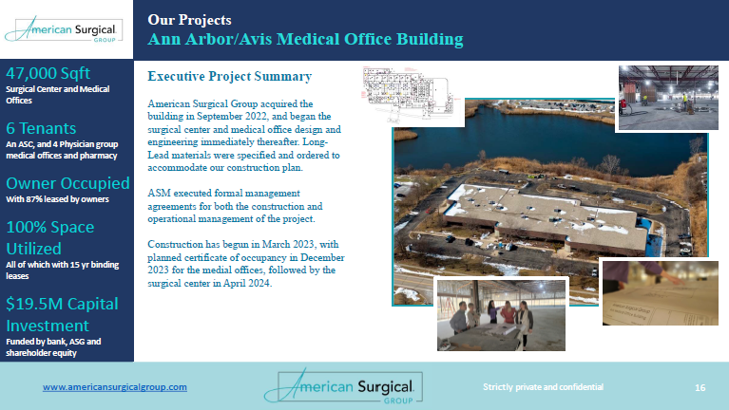

Slide 33
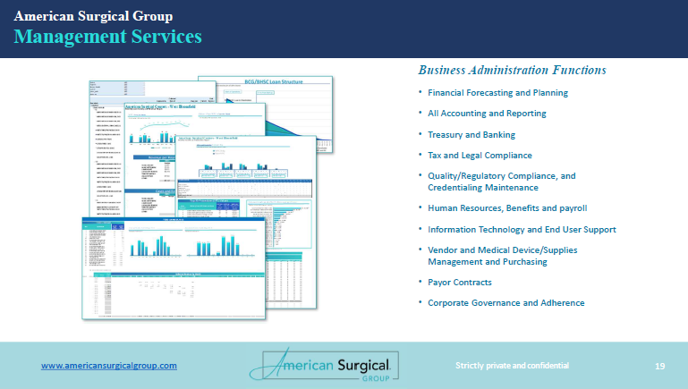

Slide 34
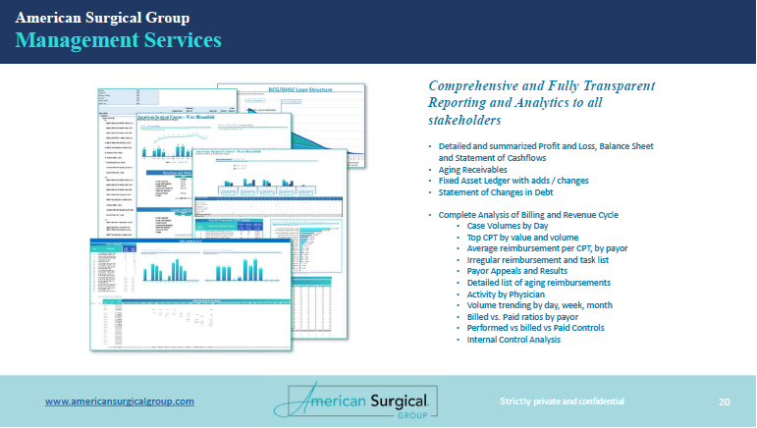

Slide 35
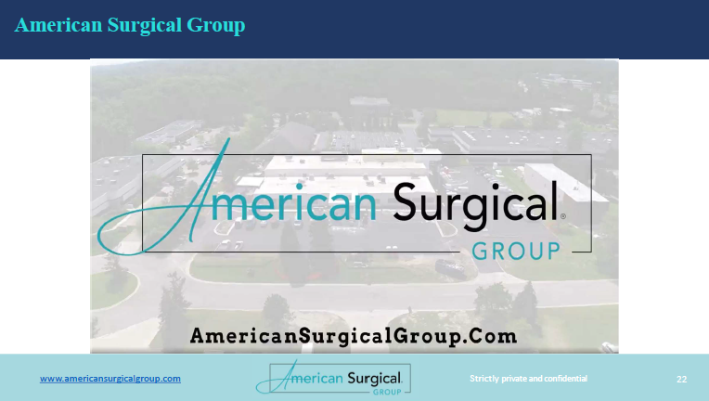

Slide 36
